Slide 1
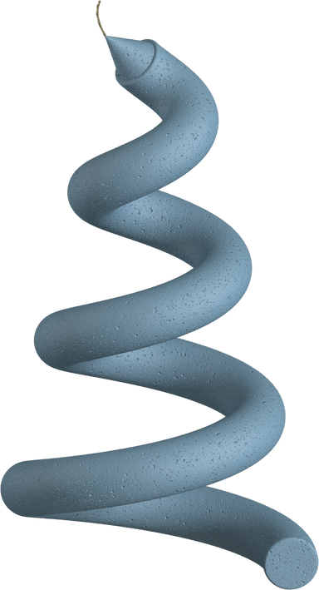
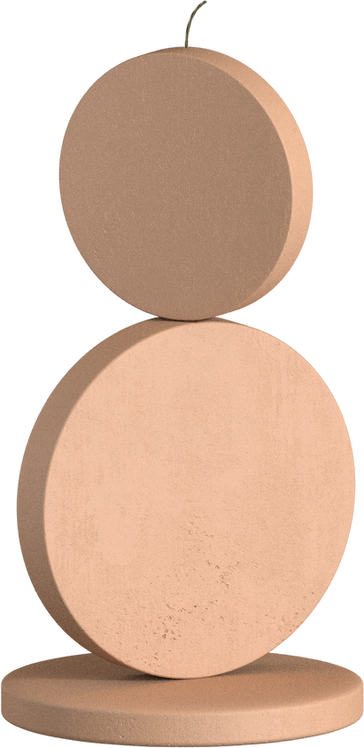
3D Concrete Printing Laboratory
Established in April 2021 at RTU this lab is the first 3D concrete printing scientific laboratory in the Baltics

Slide 2
3D printing concrete
01
Founding story
02
How to print concrete
03
Purpose and ambition
RTU lab tour
04
What happens in the lab
06
Future
+
Jargon

Slide 3
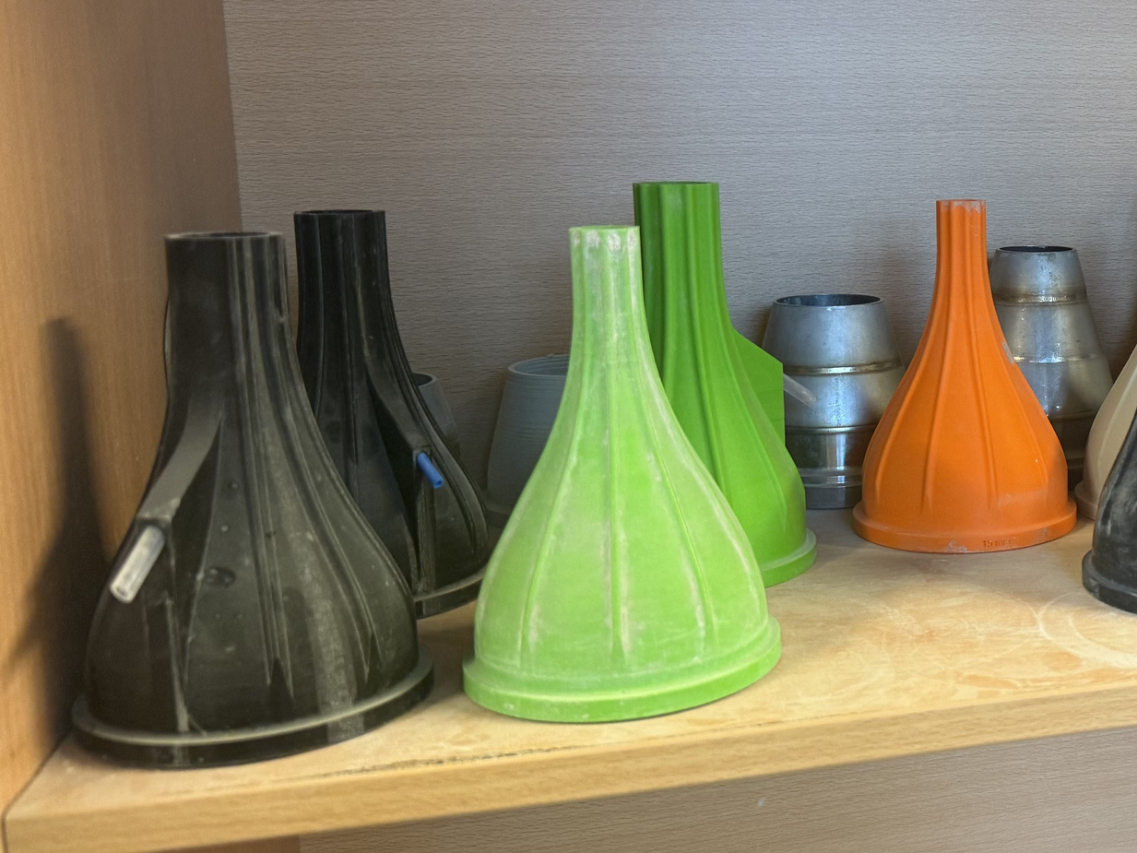
Now the lab uses a gantry • 3D printer that is the 10th iteration of the original
Founding story
Founded in 2021 by RTU in cooperation with SAKRET
The founder started with a hand held extruder •
nozzles • used in concrete 3D printing

Slide 4
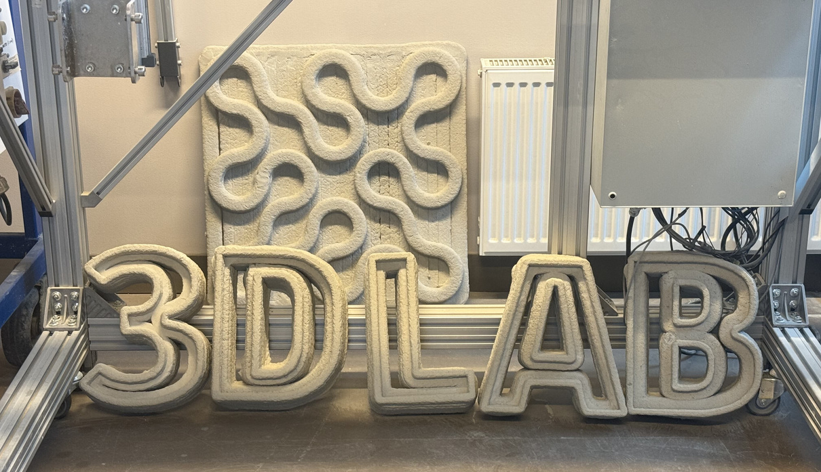
Printing concrete
Important points
01
Cement without aggregate •
02
Hardening agents
03
Parametric modeling
04
Just like a traditional printer

Slide 5
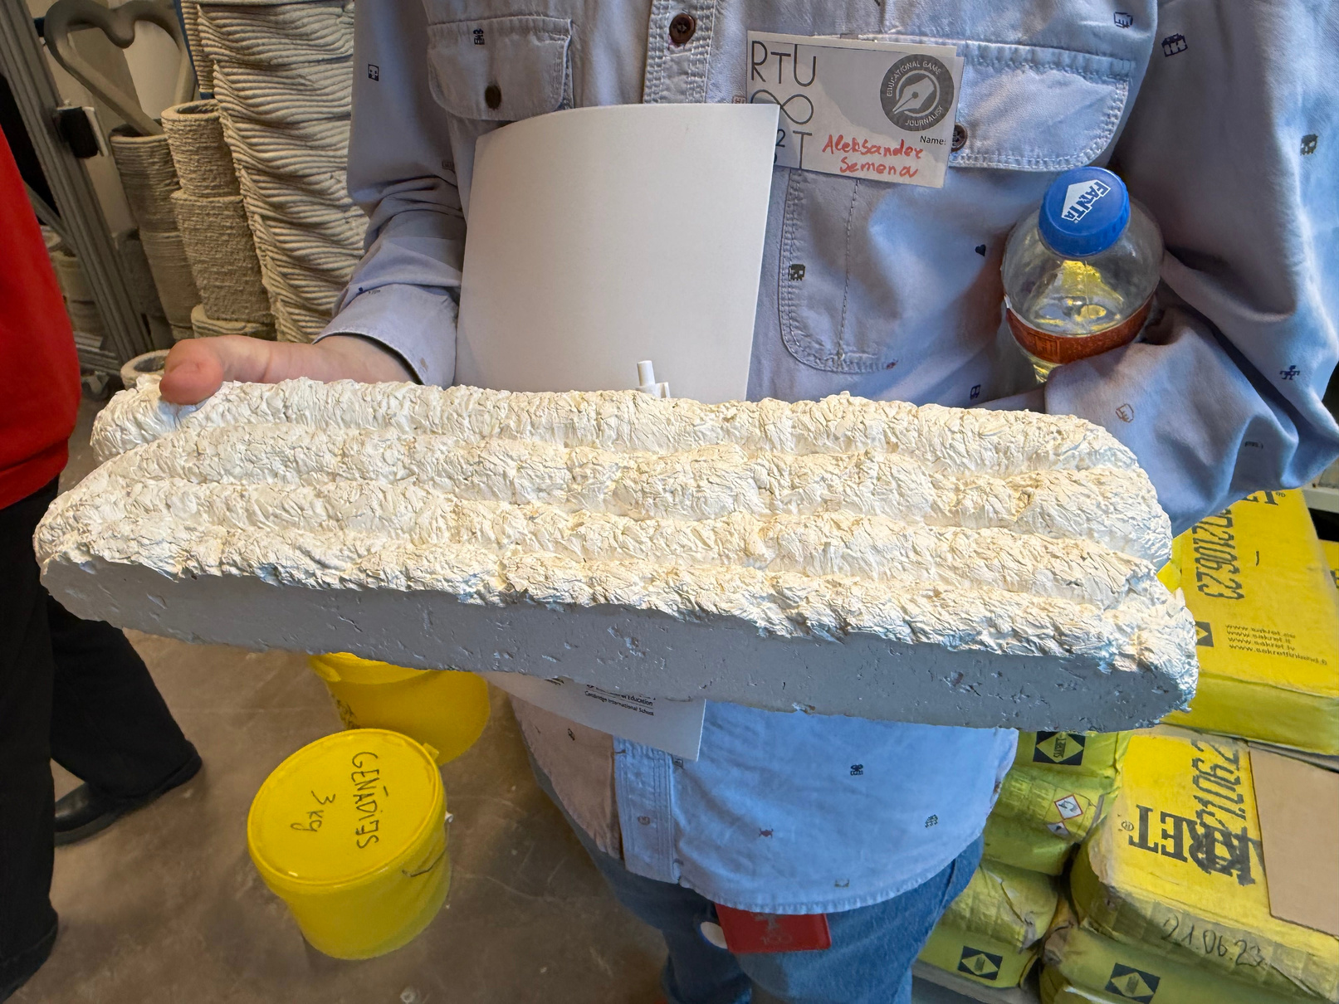
Most of the projects that are conducted in this lab are with the purpose of making building sustanable
Ambitions
The lab also creates 3D printable versions of all their new materials testing the viability of 3D printing them
A material made from organic matter

Slide 6
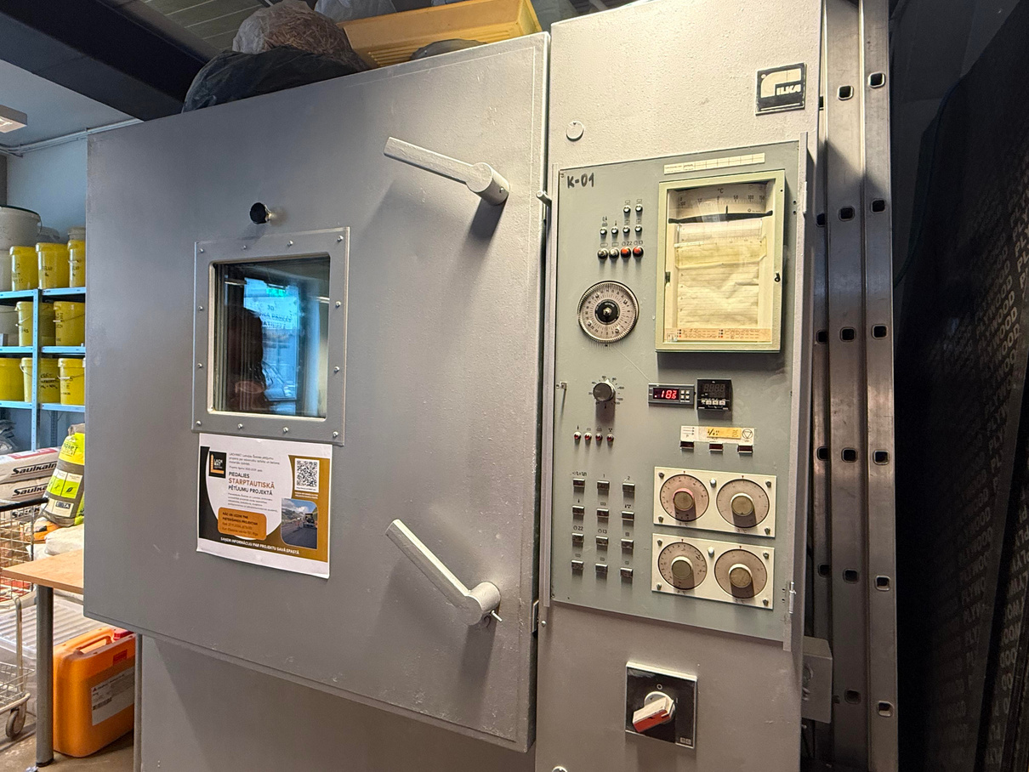
The Lab
And The real work
Freeze cycle tester •
REASERCH
LAB WORK
TESTING
The researcher does 90% of the work outside of the lab(doing research of course)
Printing and designing materials ( and a lot of trial and error )
The 3D prints are put through various tests to see if they are viable in construction

Slide 7
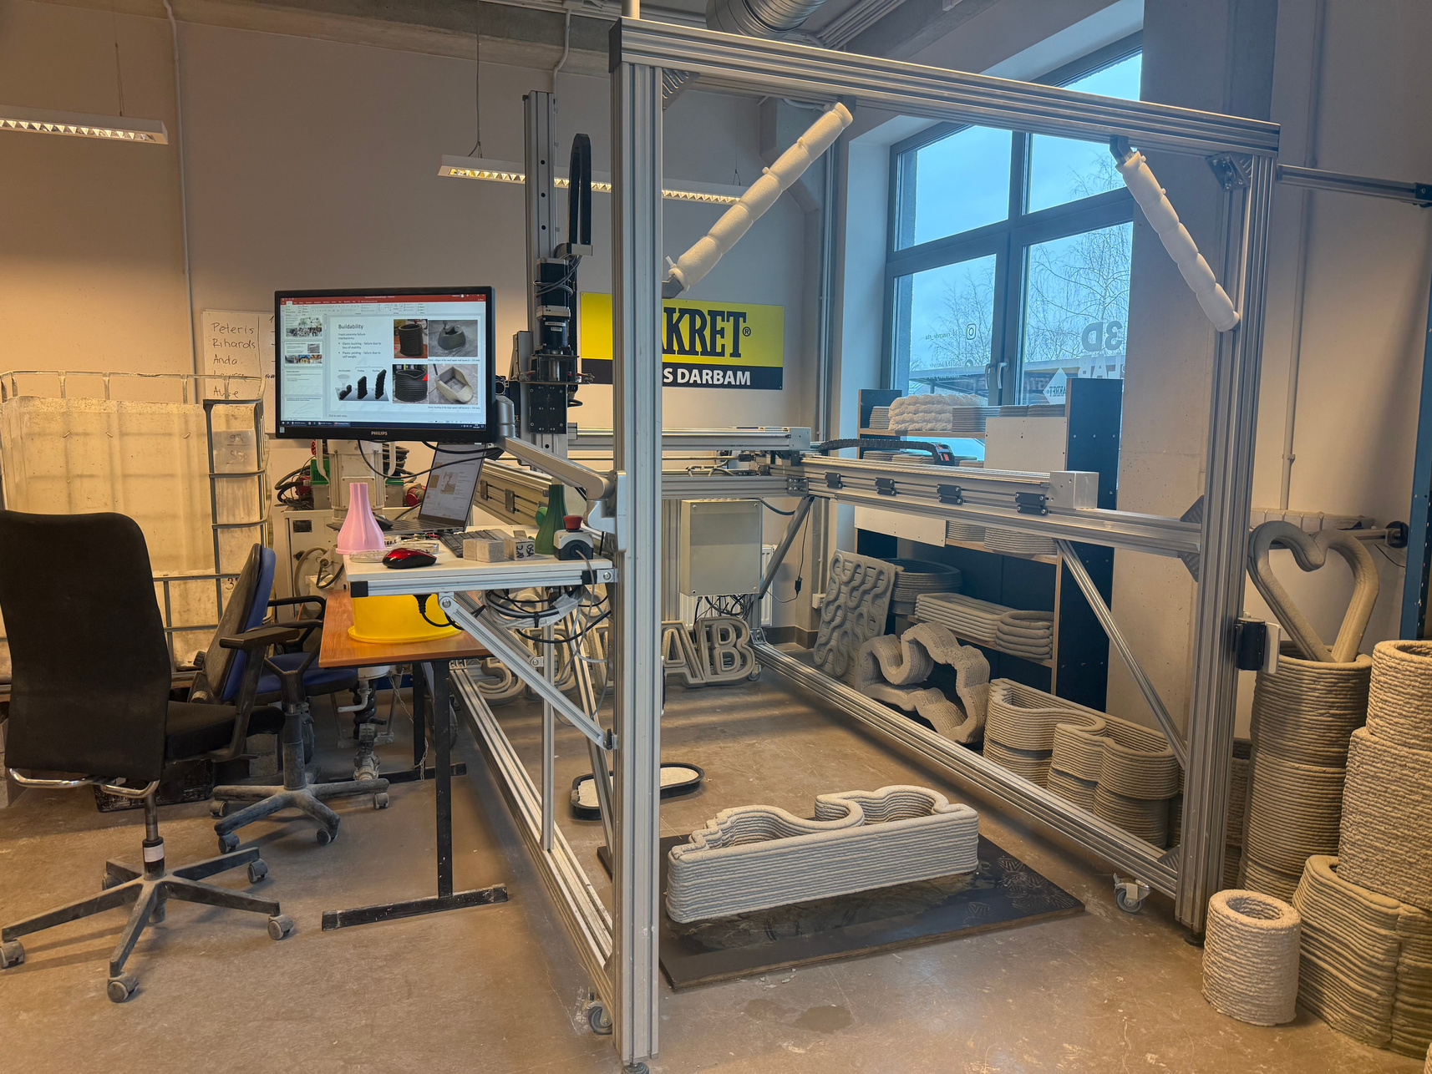
Future
CONTINUE INSPIRING
CONTINUE WORKING
CONTINUE 3D PRINTING

Slide 8
Recap of jargon
  Extruder – The component that pushes out concrete in a controlled manner.
  Gantry – A movable frame that guides the printer’s extruder.
  Nozzle – The opening through which concrete is deposited.
  Aggregate – Small particles added to concrete for strength.
  Freeze Cycle – Repeated freezing and thawing that affects concrete durability.

Slide 9

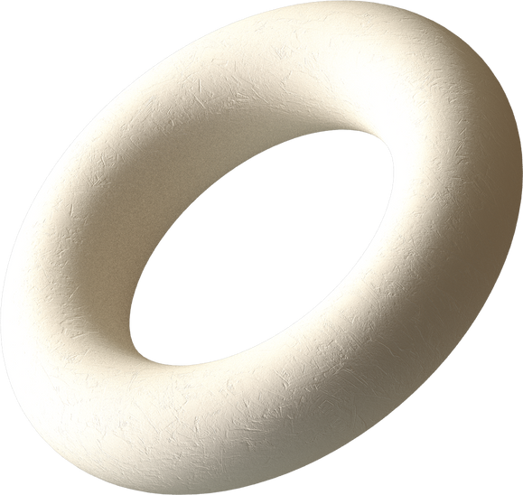
Do you have any questions?

Slide 10
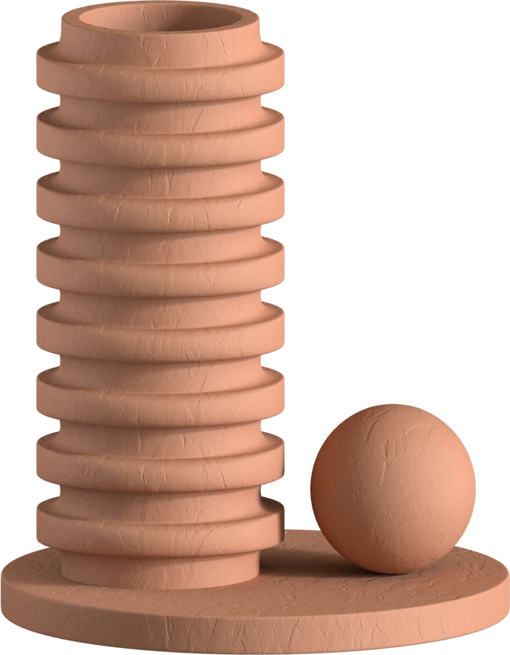
Thank you for listening
Made by : Kristiāna, Aleksander, Mihail, Kirill

