Slide 1
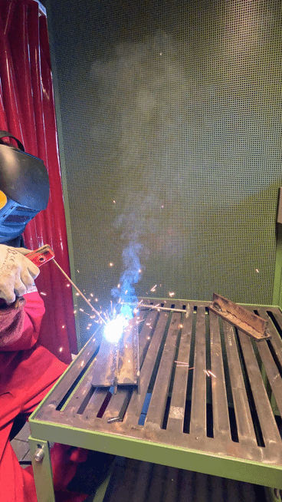
Welding: Melting Metal Like a Pro!

Slide 2
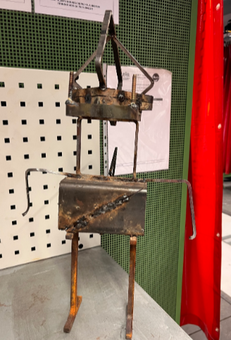
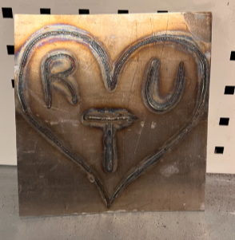
What is Welding?
Definition:
Welding is basically metal fusion—melting and joining metal parts together.
It’s been around for over 2,000 years—even Vikings used it!
Why It’s Important:
Without welding, we’d have no cars, no roller coasters, no TikTok ring lights—imagine that!
Everything from bridges to spaceships needs welding.

Slide 3
TIG Welding (Tungsten Inert Gas)
Types of Welding
MIG Welding (Metal Inert Gas)
Stick Welding (Shielded Metal Arc Welding)
Flux-Cored Arc Welding (FCAW)
Precise & fancy—used for things like race cars and fine metalwork.
If MIG is like drawing with a Sharpie, TIG is like drawing with a fine-tip pen.
Think hot glue gun, but for metal.
Used for cars, furniture, and home projects.
Easy to learn, but watch out for spatter!
The tough guy of welding—good for outdoor and heavy-duty projects.
Downside? Looks kinda messy—like when you try to frost a cake but fail.
Similar to MIG, but works better outside in the wind.
More sparks = More drama (but also more cleanup).

Slide 4
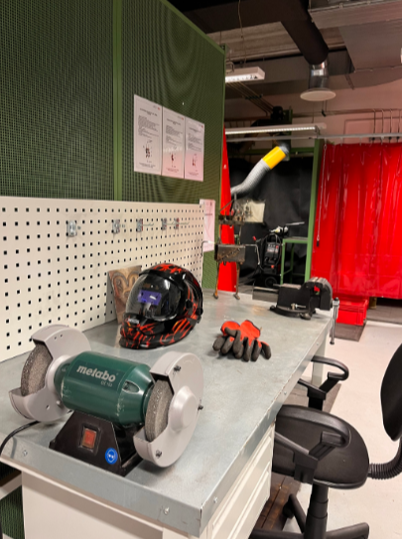
Safety First!
(Seriously, Unless You Want a New Nickname Like ‘Toasty’)
Gear Up or Regret It: Welding Helmet – Unless you enjoy temporary blindness (arc flash). Gloves – Because metal is HOT (shocker, I know). Long Sleeves – Trust me, a welding spark in your hoodie is NOT fun. Boots – Because dropping molten metal on your sneakers = bad day.
Common Welding Hazards: Arc Flash: Like staring at the sun… but worse. Wear your helmet! Burns: Metal stays hot after welding—so don’t high-five it. Fire Hazards: Sparks can fly up to 35 feet—so maybe don’t weld near your backpack.

Slide 5
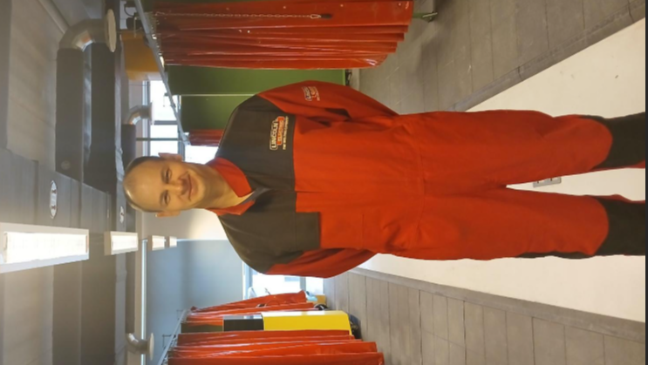
Didzis Avišāns
Didzis is an expert at welding and has worked in laboratory for 5 years.
Really cool guy!!!
Mg. sc. ing. → He has a Master’s degree in Engineering.
PhD in progress → He has a doctorate (PhD).
IWE (International Welding Engineer) → He is a certified expert in welding.
Lecturer & Teacher → He teaches welding and engineering.
Negotiation Specialist → He is skilled in business and technical deals.

Slide 6
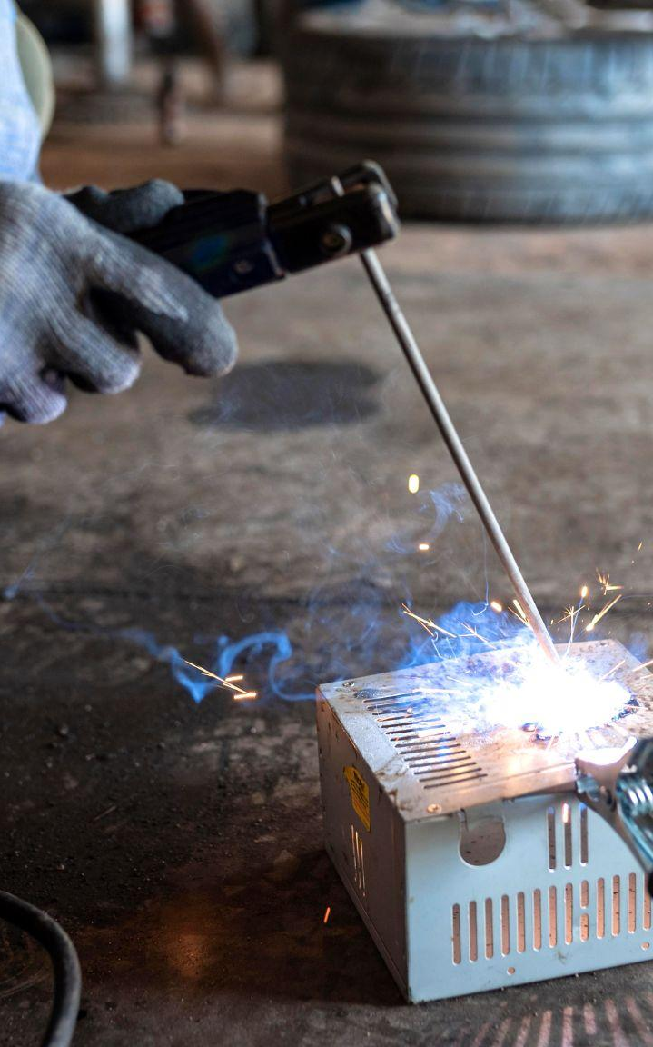
Plans for future
Metal 3D printer
Laser welding
Co-bot
A Metal 3D Printer is a machine that prints objects using metal, just like a regular 3D printer but with metal powder or wire instead of plastic.
A laser beam melts and joins metal parts together. It’s fast, precise, and clean.
A Cobot (Collaborative Robot) is a robot that works safely with humans. Unlike big industrial robots, cobots are smaller, smarter, and safer!

Slide 7

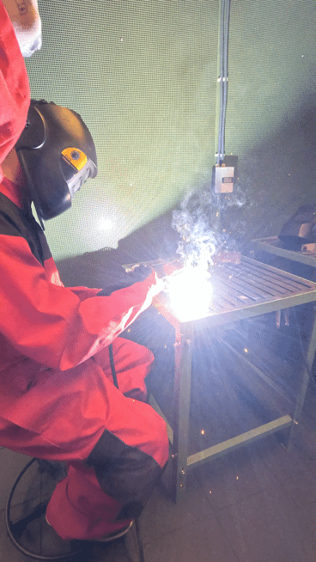
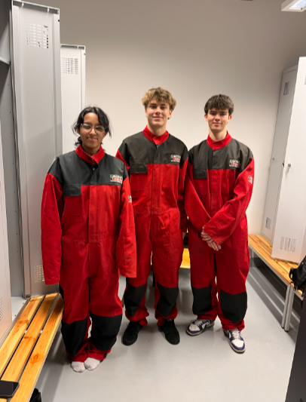
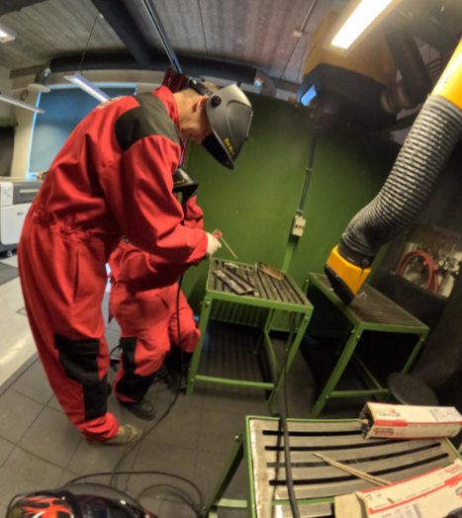
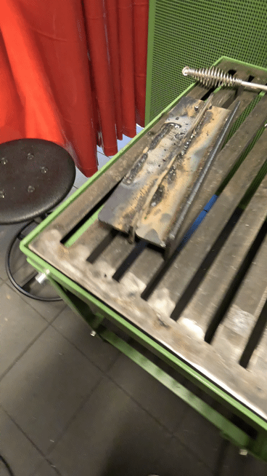
Our own experience

Slide 8
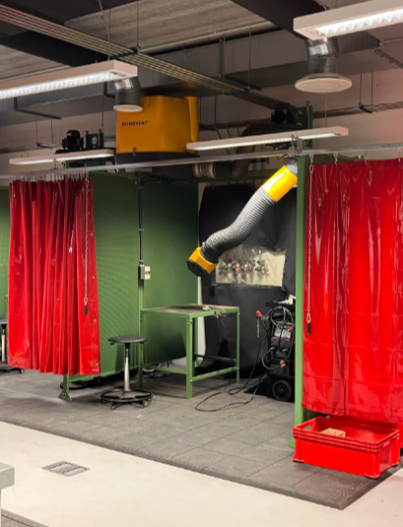
Their jargon
MIG/MAG
EYES
MMA
TIG
WELDING
Gas Metal Arc Welding
Put on a helmet!
Manual Metal Arc welding
Tungsten Inert Gas welding
Just weld and be happy!

Slide 9
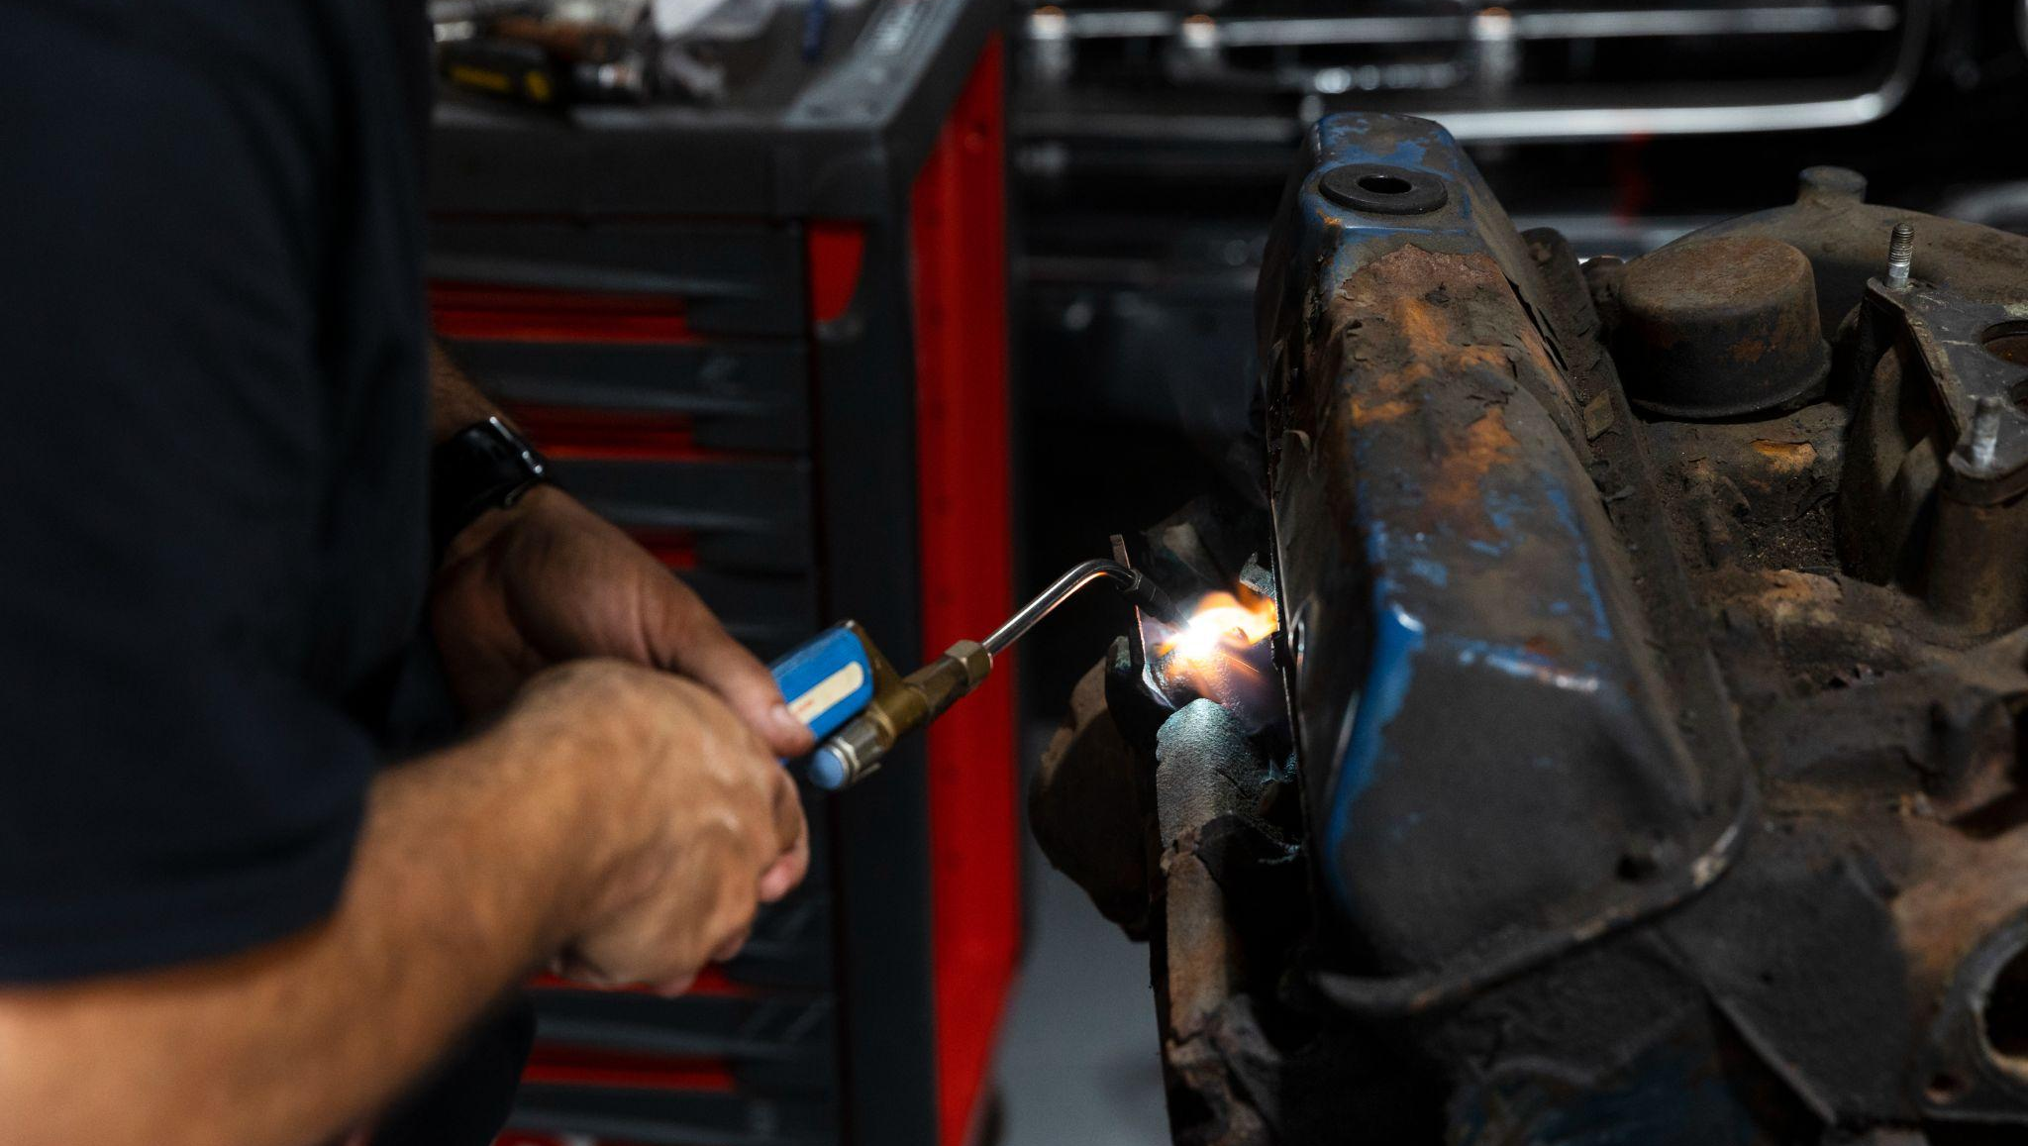
Thank You!
Ralfs Skavronskis, Alberts Cupriks, Bheeni Vig

