Slide 1
Accredited Laboratory for Personal Protective Equipment
Arsenijs Krasovskis
Aleksandrs Sergejevs
Nikolas Kaipovs
Petr Shvab
Notes:
This is RTU’s PPE Laboratory, where we test protective clothing and equipment. The lab opened in 2020, during COVID-19, to test masks. Today, it has more testing machines than any other lab in Europe. We check how well clothing works in heat, cold, fire, rain, and other tough conditions.

Slide 2
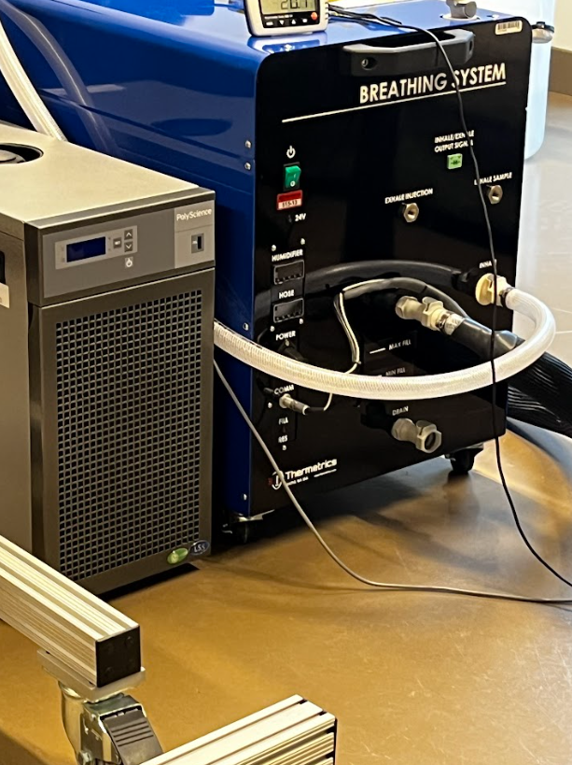
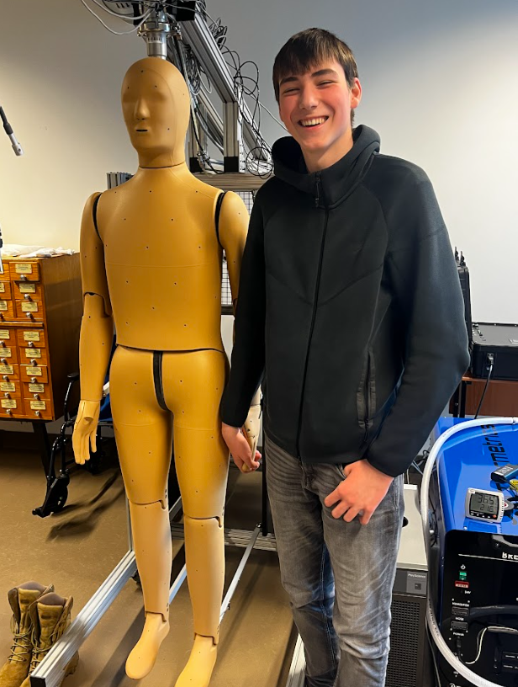
Table of content
About the Lab
Established in 2020 during COVID-19
From mask testing to leading European lab
Global Partners
Clients from Estonia to Brazil
Horizon project with Adidas
Equipment & Technology
Climate chamber, strength testers, 3D scanner
Breathing machine for masks
Thermal Mannequin Andy
One of 13 in the world
Tests clothing in extreme conditions
Future plan: dedicated climate chamber
Future Goals
Focus on bio-friendly textiles and innovation
Notes:
The lab works with companies from many countries, like Estonia and Brazil. Right now, we are part of the Horizon project, working with Adidas to make a new type of fabric that is good for the planet and works well for protective clothing.

Slide 3
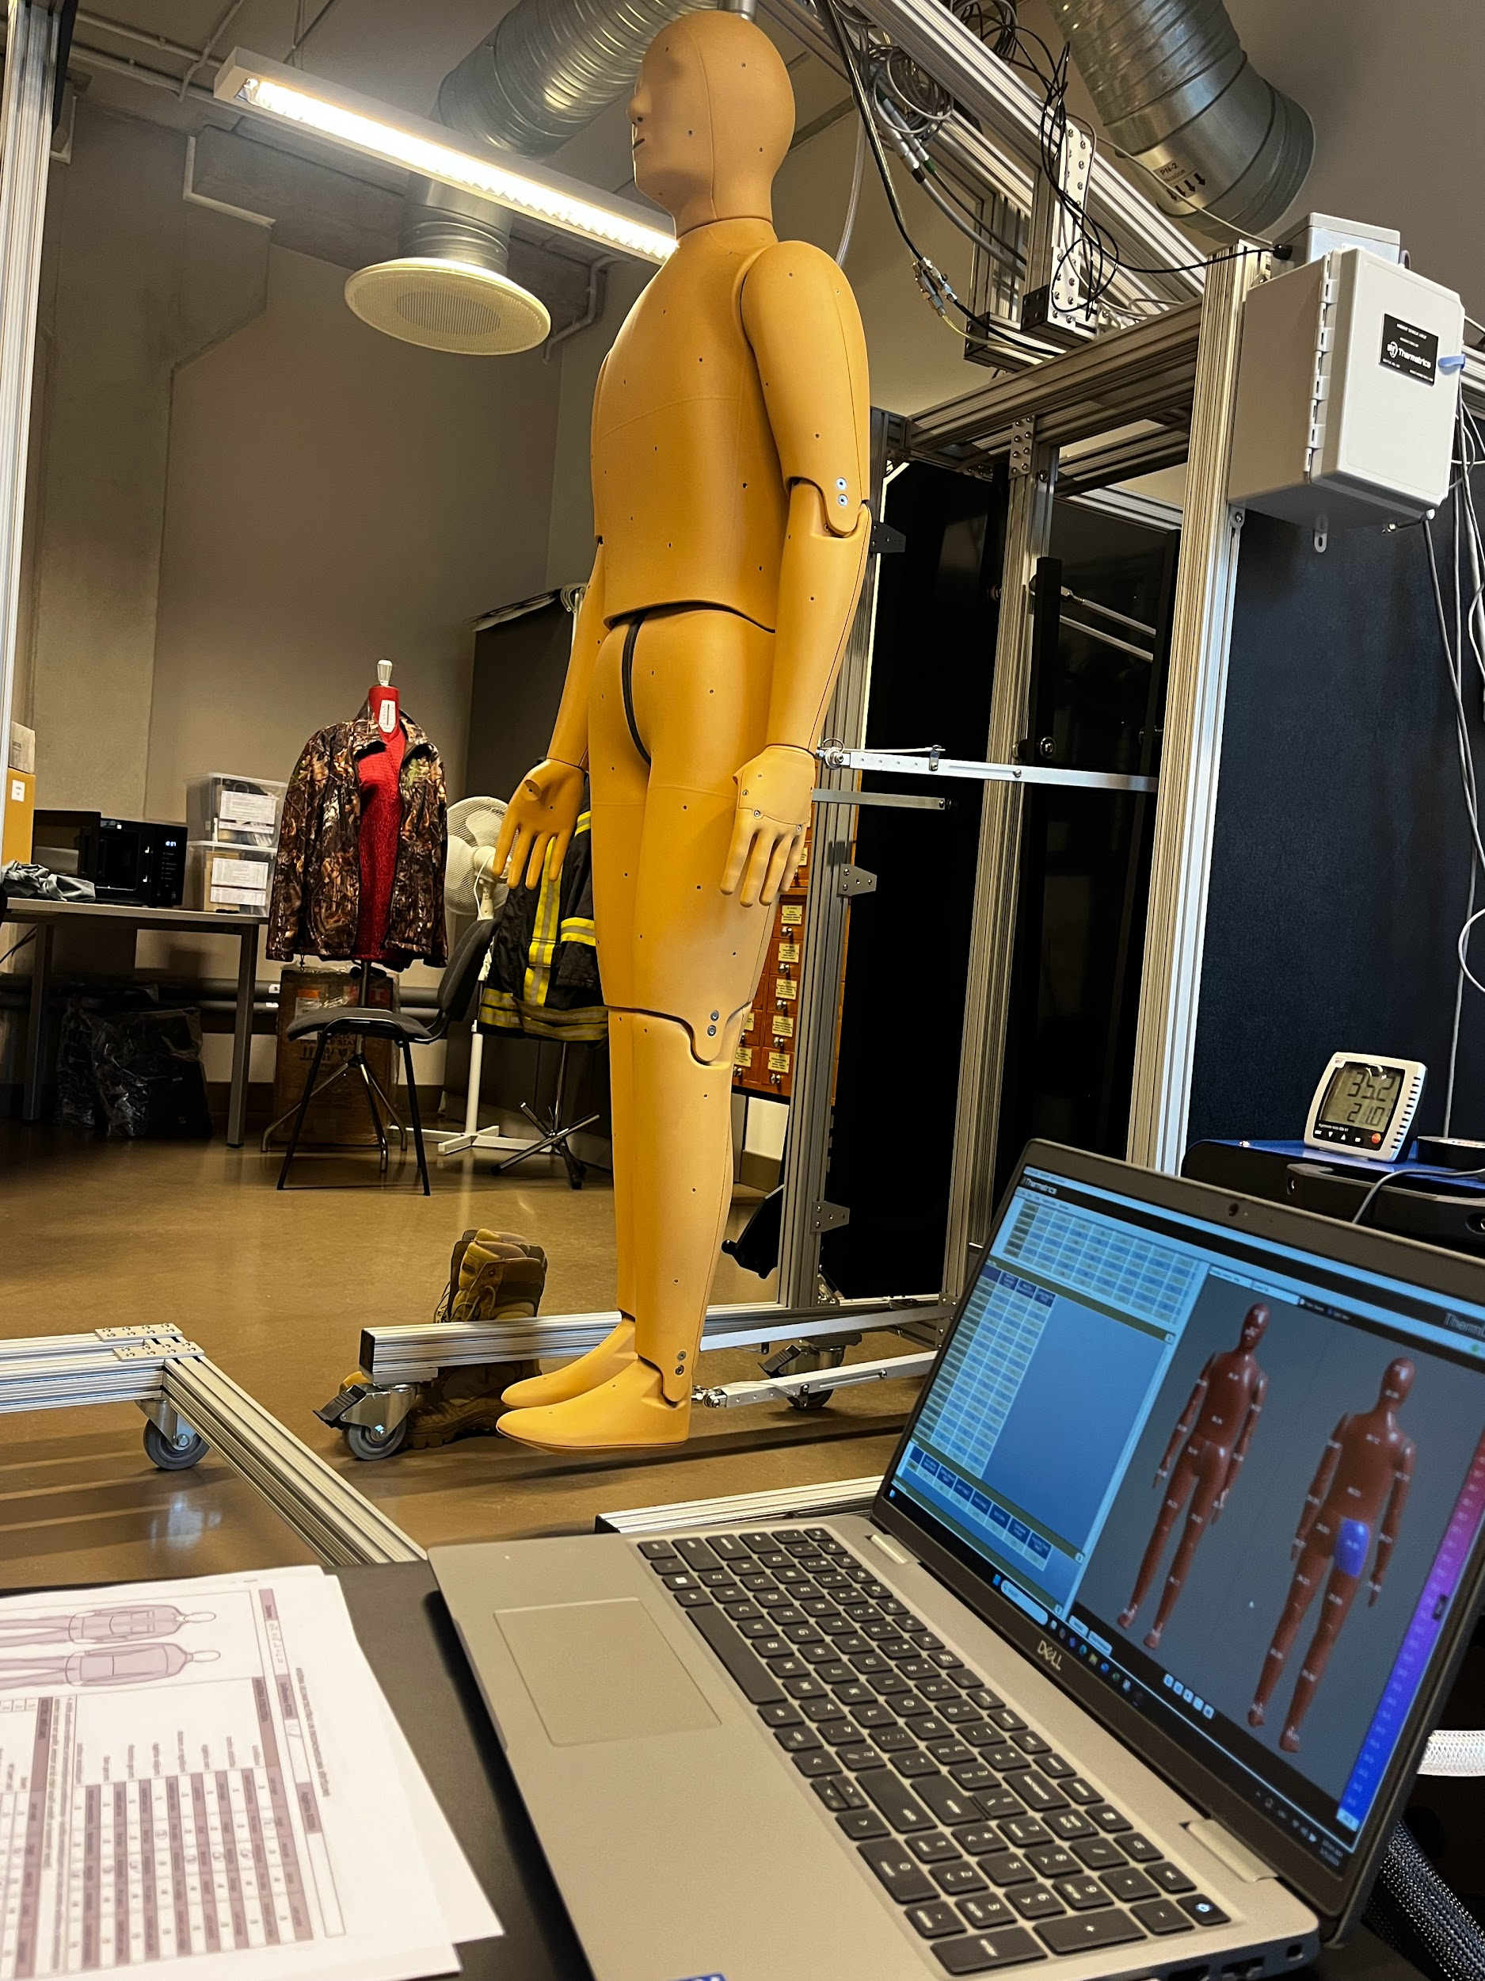
Who is Andy?
Andie is the lab’s thermal mannequin, a 35 kg high-tech robot designed to test how clothing protects the human body in extreme conditions. Andie can be dressed in underwear, workwear, or protective gear and placed inside the climate chamber, where temperatures range from -40°C to +50°C.
There are only 13 mannequins like Andie in the world, making him a rare and valuable piece of testing technology. Andie helps the lab compare test results with real human data, making clothing tests both scientific and realistic. In the future, the lab plans to build a larger climate chamber designed just for Andie.
Fun fact: In Germany, a similar mannequin can even inflate its muscles to simulate body movement!
Notes:
The lab is full of different machines. Some pull and stretch fabrics, others test water resistance. There is also a climate chamber where we change the temperature from -40°C to +50°C. For masks, we use a breathing machine that breathes like a real person. A 3D scanner helps us check how clothes fit and move on the body.

Slide 4
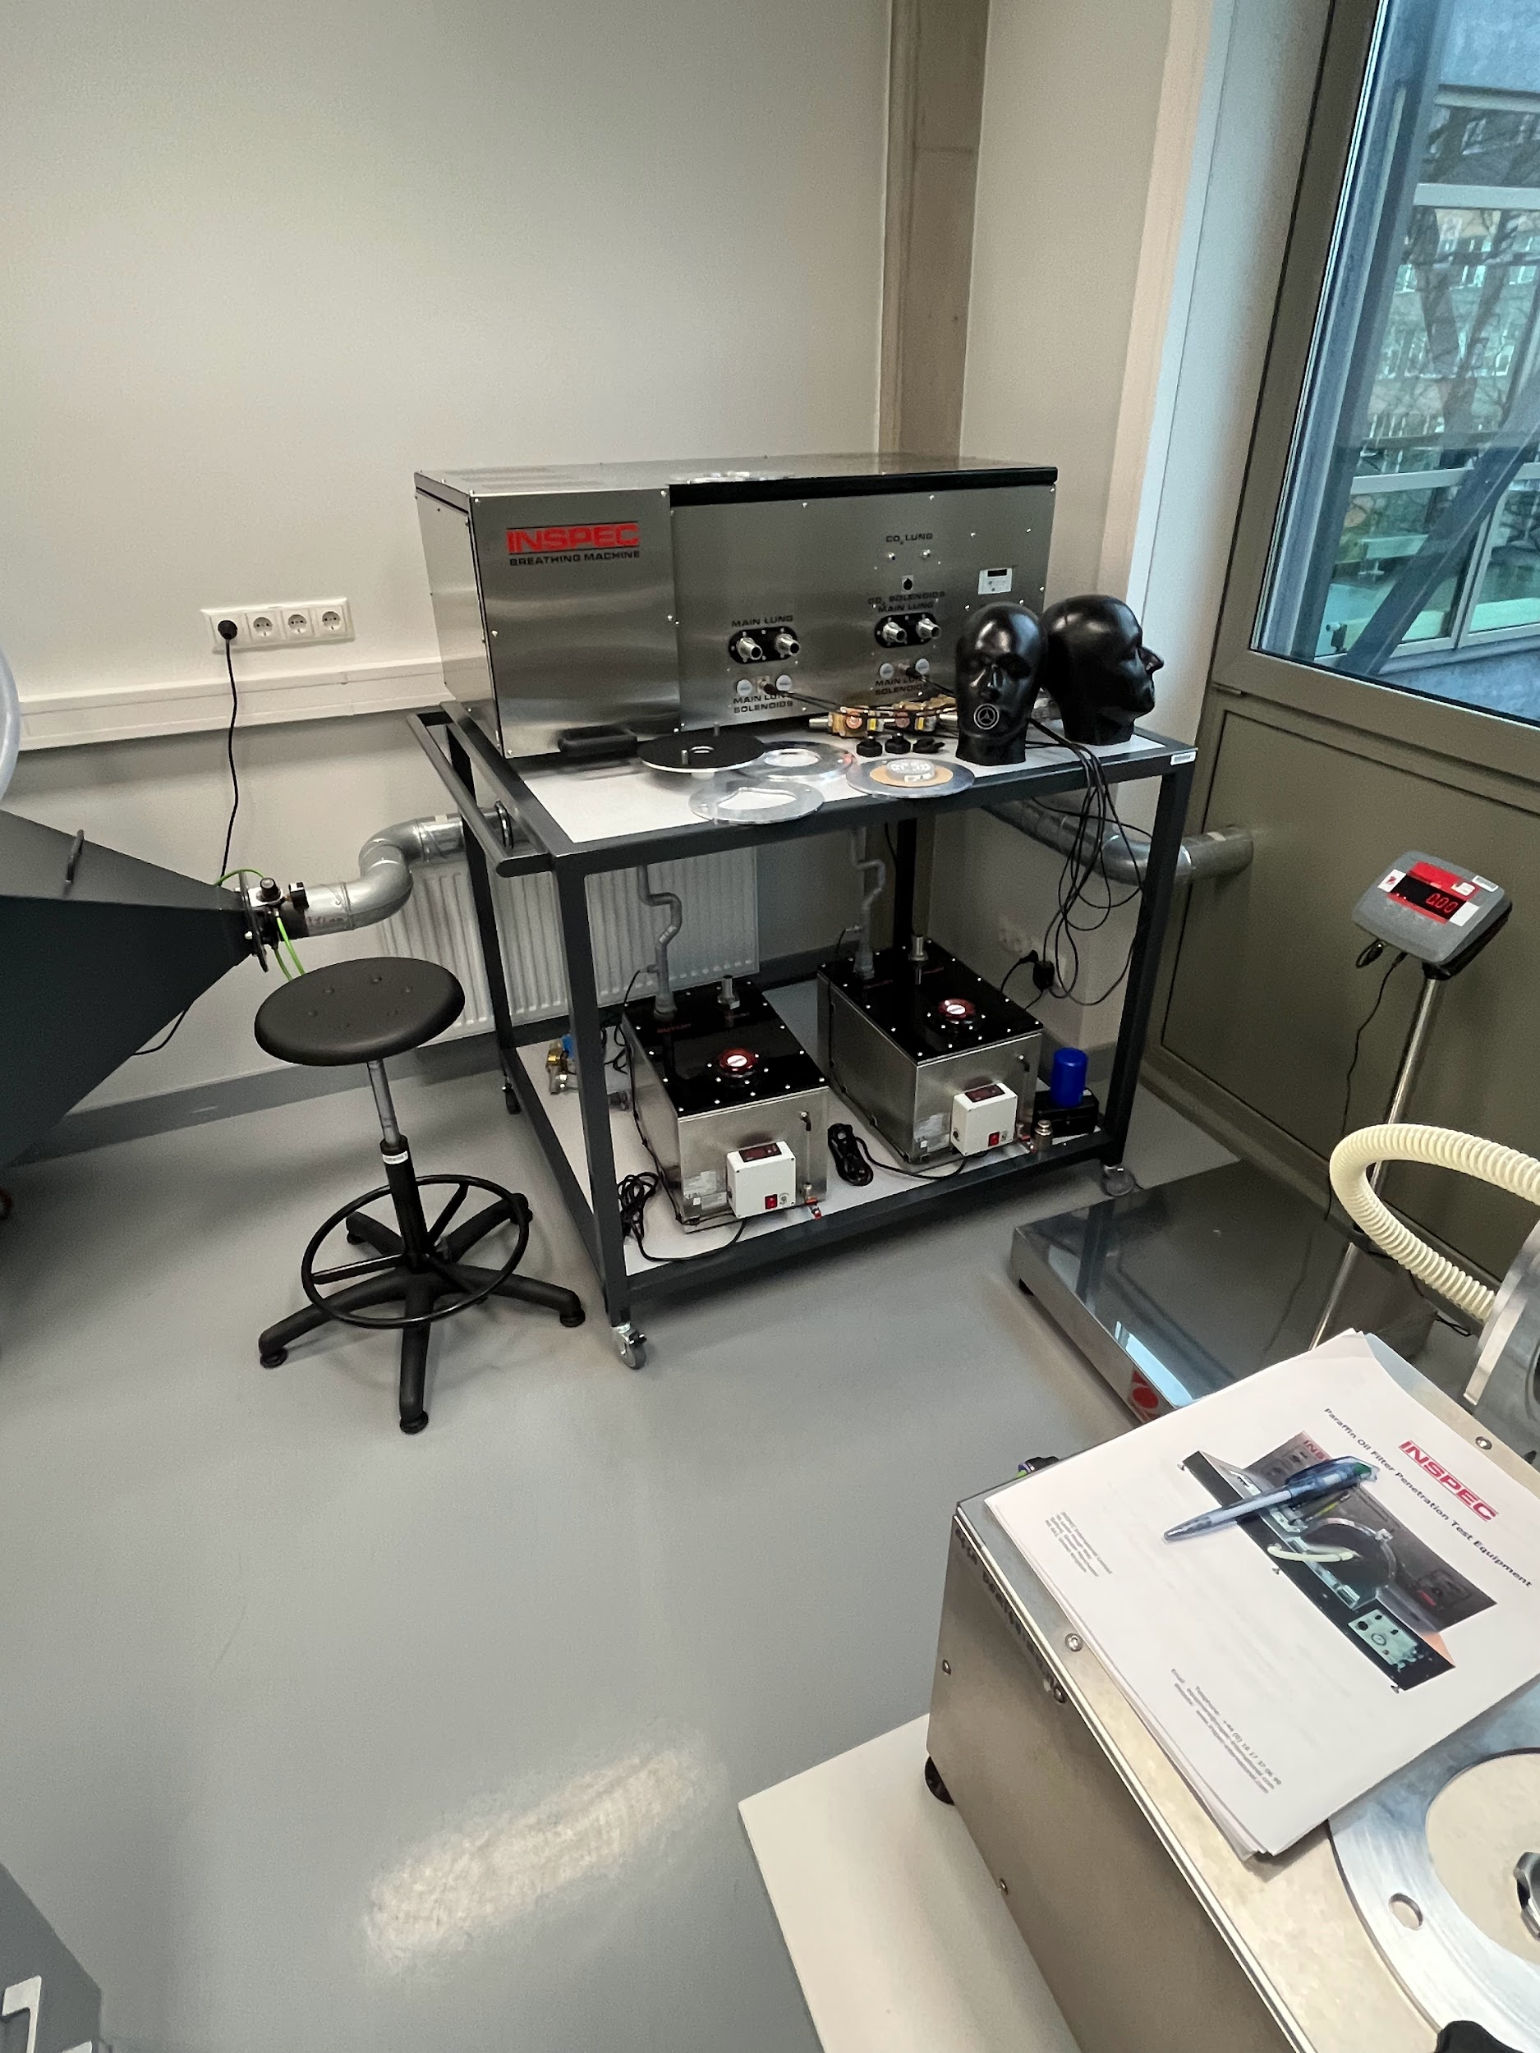
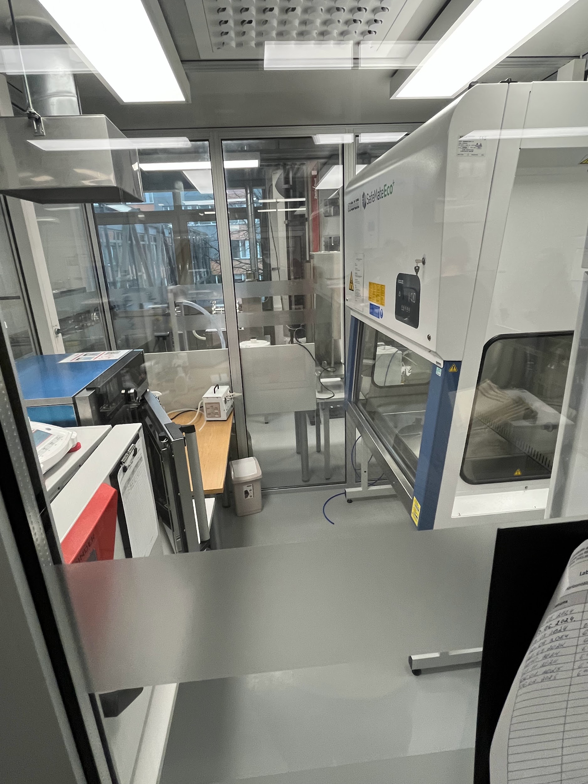
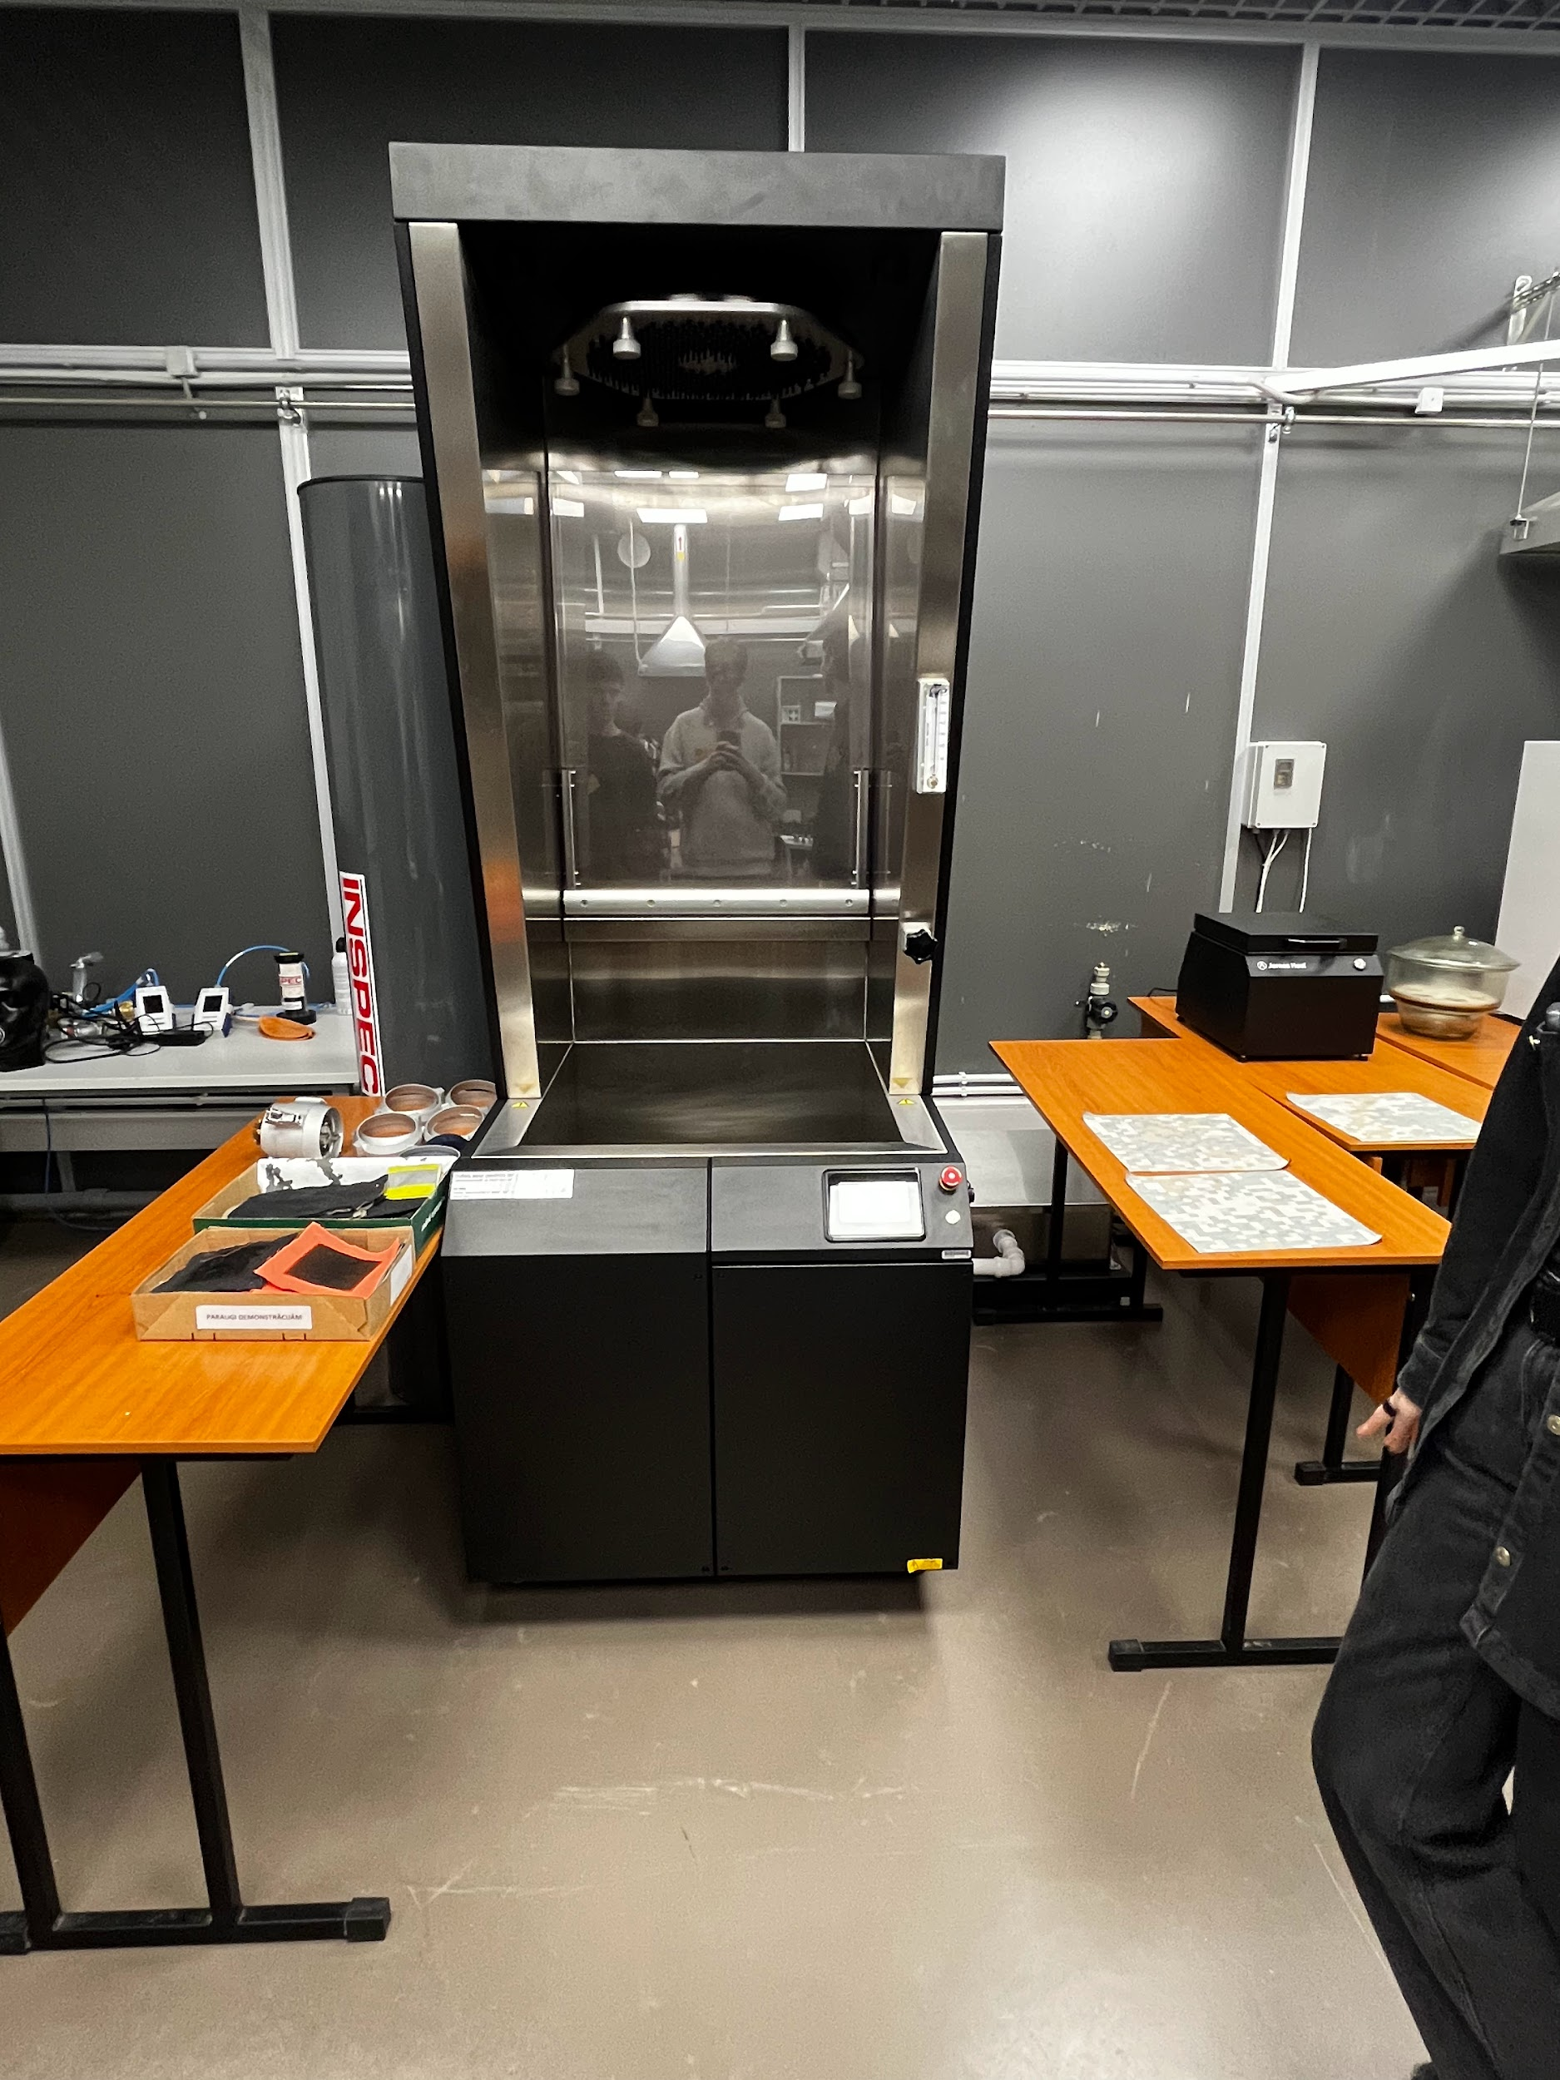
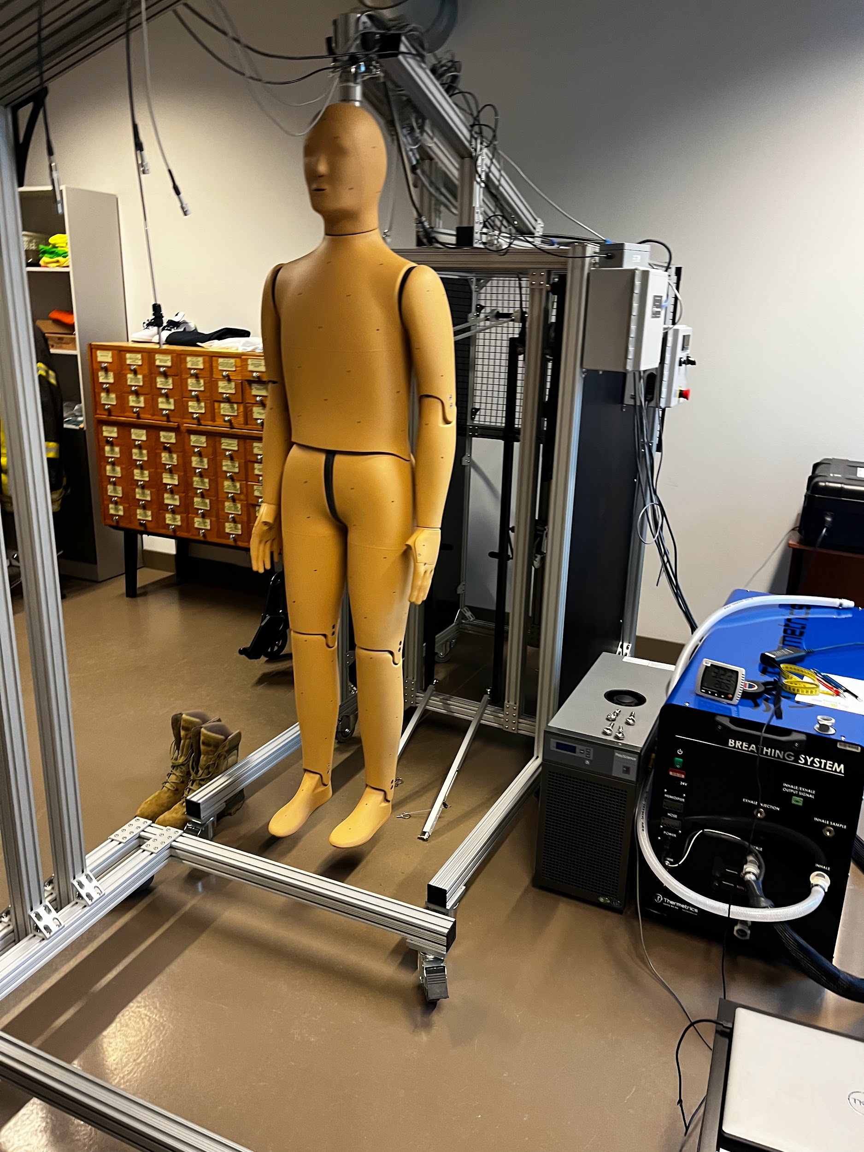
Main information about laboratory
The laboratory was established in 2020 during COVID-19 pandemics, for the purpose of testing protection masks. The laboratory later developed and right now it has more testing equipment than any other laboratory in Europe.
Companies from many different countries, ranging from neighbours in Estonia to Brazil, cooperate with the laboratory.
Right now, the laboratory works on an international “Horizon” project with companies like Adidas. Their goal is to create an innovative, bio-friendly textile material.
Notes:
In the future, the lab wants to create new eco-friendly materials, test even more protective gear, and work with more companies around the world. The goal is to make sure clothing keeps people safe — and helps the planet too.

Slide 5
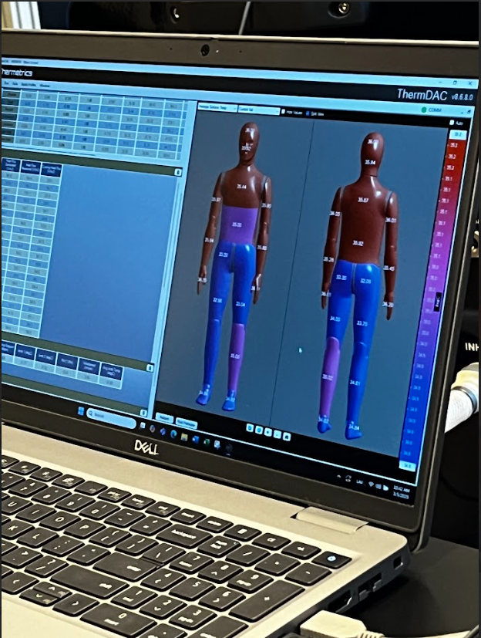
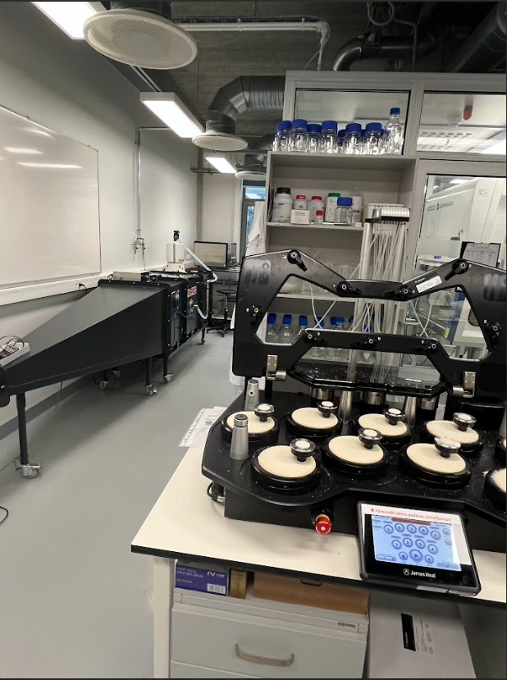
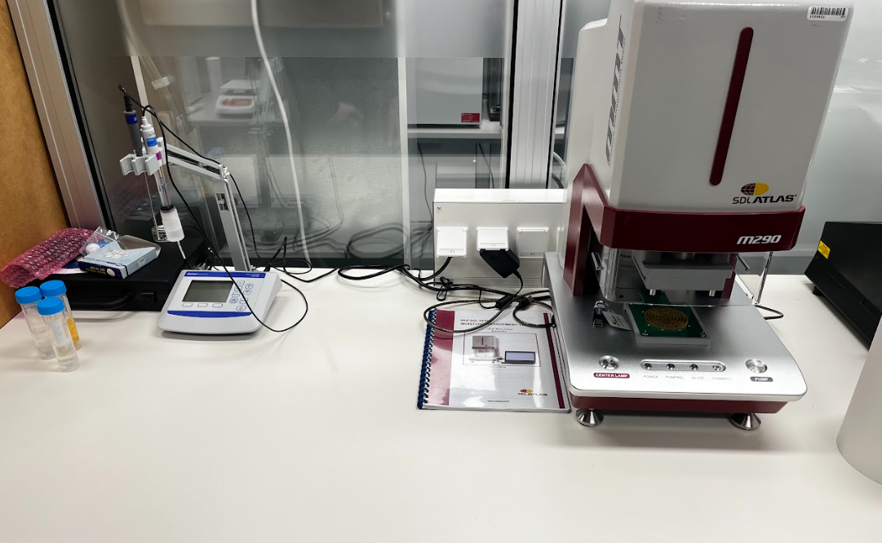
Types of machines
The lab uses specialized machines to test textiles, protective gear, and PPE under extreme conditions. Key equipment includes a climate chamber (-40°C to +50°C), bursting strength tester, water resistance tester, and TPP-3 thermal performance apparatus. For protective masks, there’s a breathing machine, and body movement is scanned using a 3D Person Scanner. The lab also has a thermal mannequin, one of only 13 in the world, for realistic thermal testing. Together, these machines ensure high-quality and safety standards for materials and equipment.
Notes:
The most special machine in the lab is Andy, a thermal mannequin — a robot shaped like a person. Andy sweats, heats up, and wears different clothes to see how well they protect the body. There are only 13 mannequins like Andy in the world. The lab also hopes to build a special climate chamber just for Andy.

Slide 6
Jargon:
Climate Chamber – A special room that creates extreme temperatures, from very cold to very hot, to test how materials react.
Thermal Robot – A mannequin that heats up, sweats, and wears clothes to test how well they protect the body.
PPE – Personal Protective Equipment like masks, gloves, and protective clothing used to keep people safe.
Bursting Strength Tester – A machine that shows how much force is needed to break a fabric.
Breathing Machine – A device shaped like a head that breathes in and out to test how well masks work.

Slide 7
Thank you for your attention!

