Slide 1
Medical Engineering and Physics: Advancing Healthcare Through Technology
Kristaps, Maiks, Matīss, Ksenija

Slide 2
The main point of lab:
Medical Engineering and Physics Department at RTU, its state-of-the-art lab in shaping the next generation of medical engineers and physicists. Unlike traditional research labs, this facility is dedicated to teaching, offering students both theoretical knowledge and hands-on experience to navigate the complexities of medical technology.

Slide 3
Devices used in lab:
There are many devices in the lab, that are used in medicine, we’ll show you the main ones

Slide 4
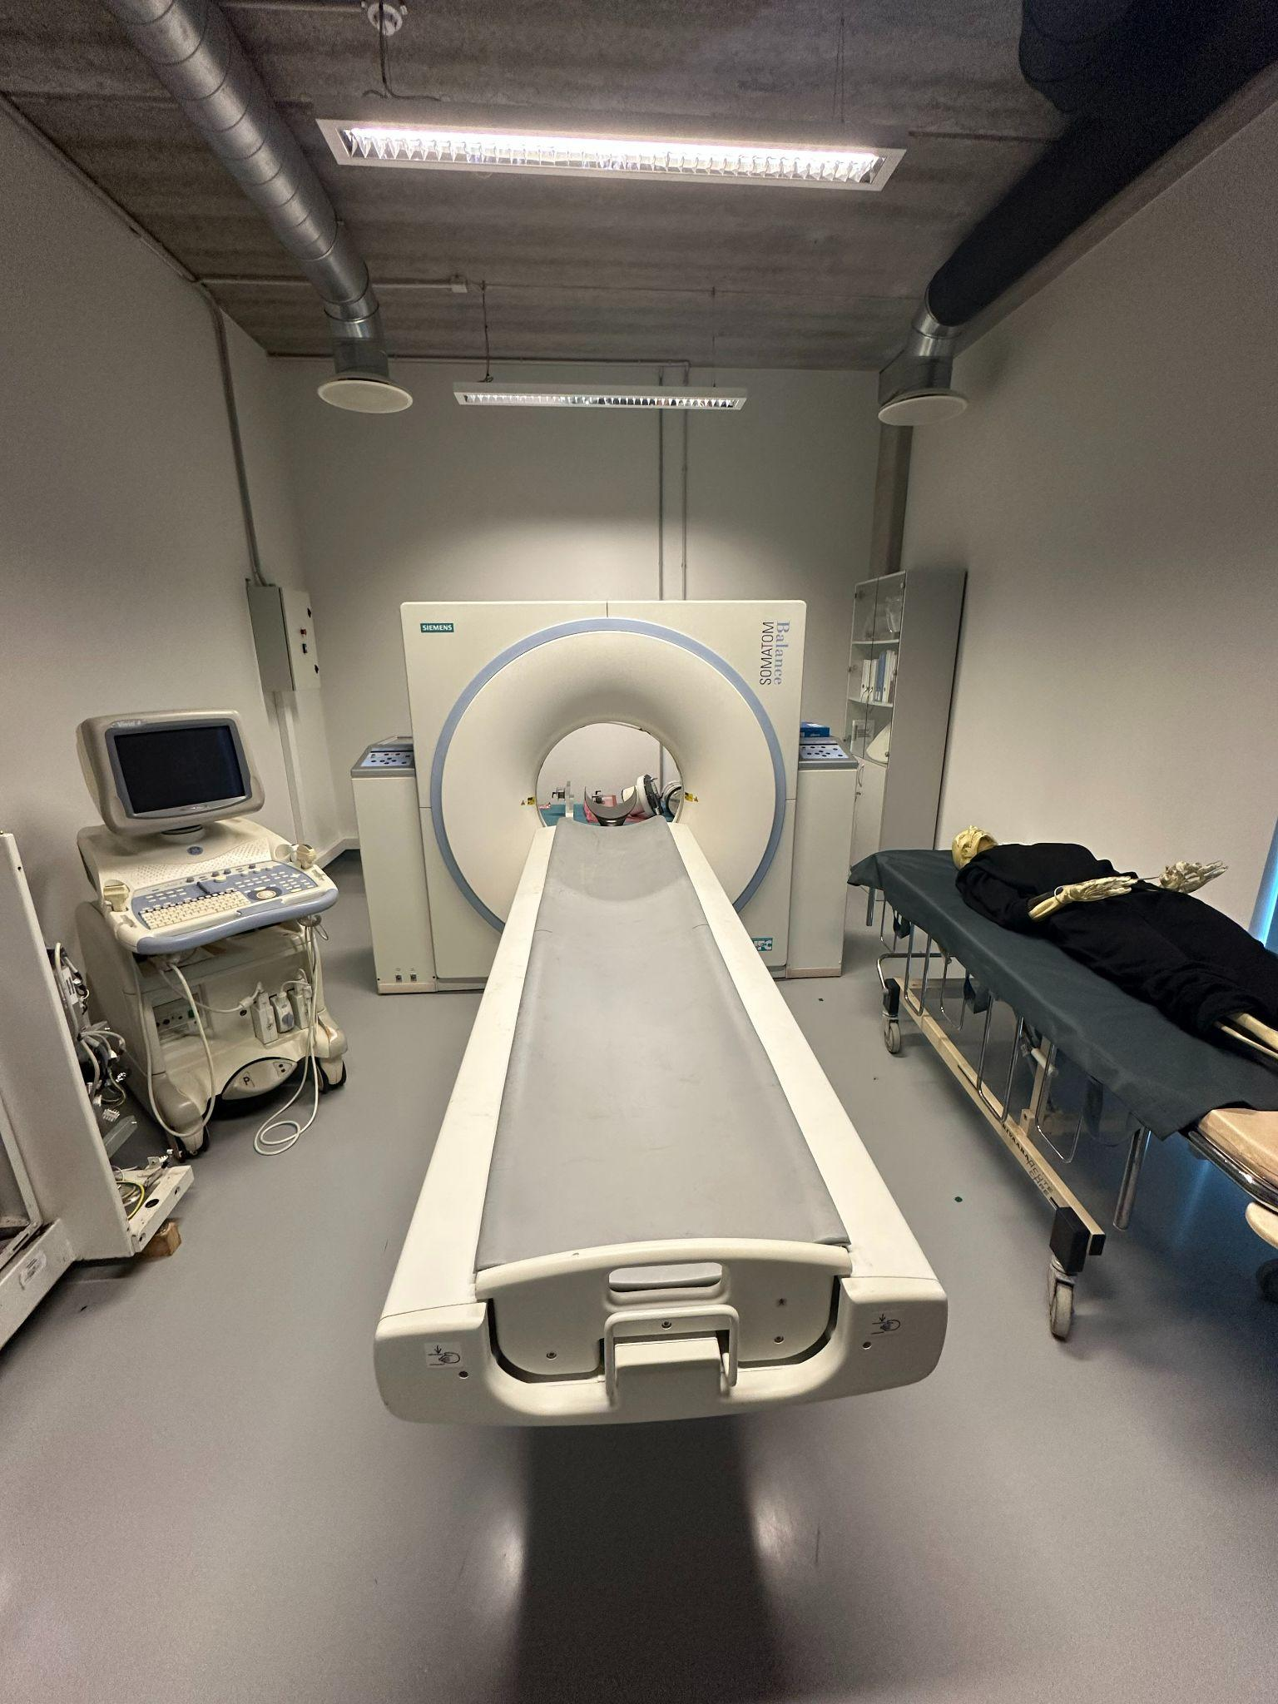
Computed Tomography (CT) scanners
They are used for advanced imaging, providing 3D views of the human body for medical diagnostics. They also utilise contrast media, such as iodine to enhance image clarity and detect abnormalities like tumors. CT scans aren’t the best for the human body so they use phantom, large acrylic tubes to measure the radiation dose delivered during a CT scan, which ensure patient safety.

Slide 5
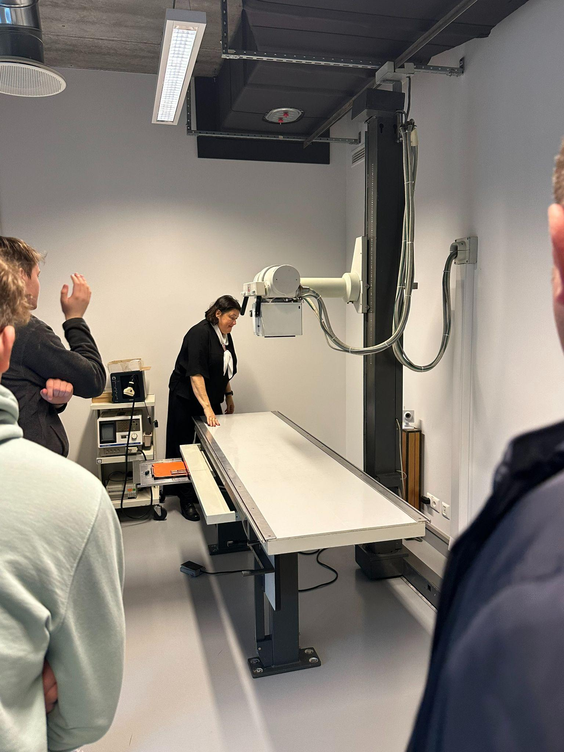
X-Ray Machine
The purpose of x-ray machines is diagnosing imaging and equipment testing, x-ray machines are essential for teaching students how to analyze and illustrate radiographic images. It also helps in studying tissue density, detecting abnormalities and calibrating diagnostic settings. This equipment allows for non medical usages such as scanning microelectronics to identify structural defects in circuit boards.

Slide 6
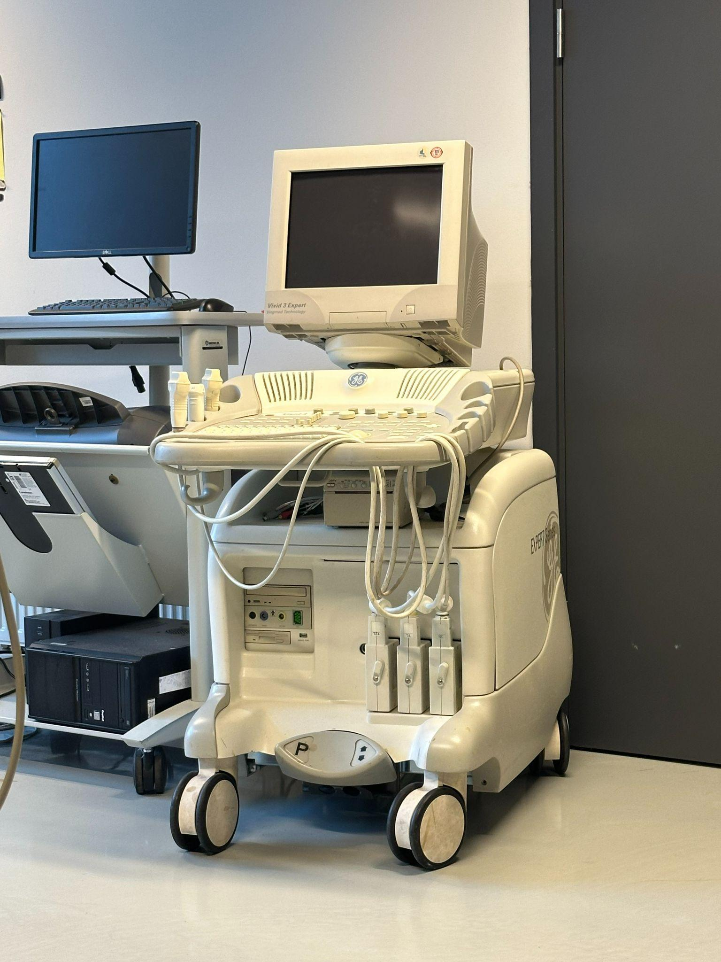
Ultrasound imaging system
The purpose of an ultrasound imaging system is to use high-frequency sound waves to create real-time images of the inside of the body. These images help medical professionals diagnose and monitor various conditions, such as examining organs, tissues, and blood flow.

Slide 7
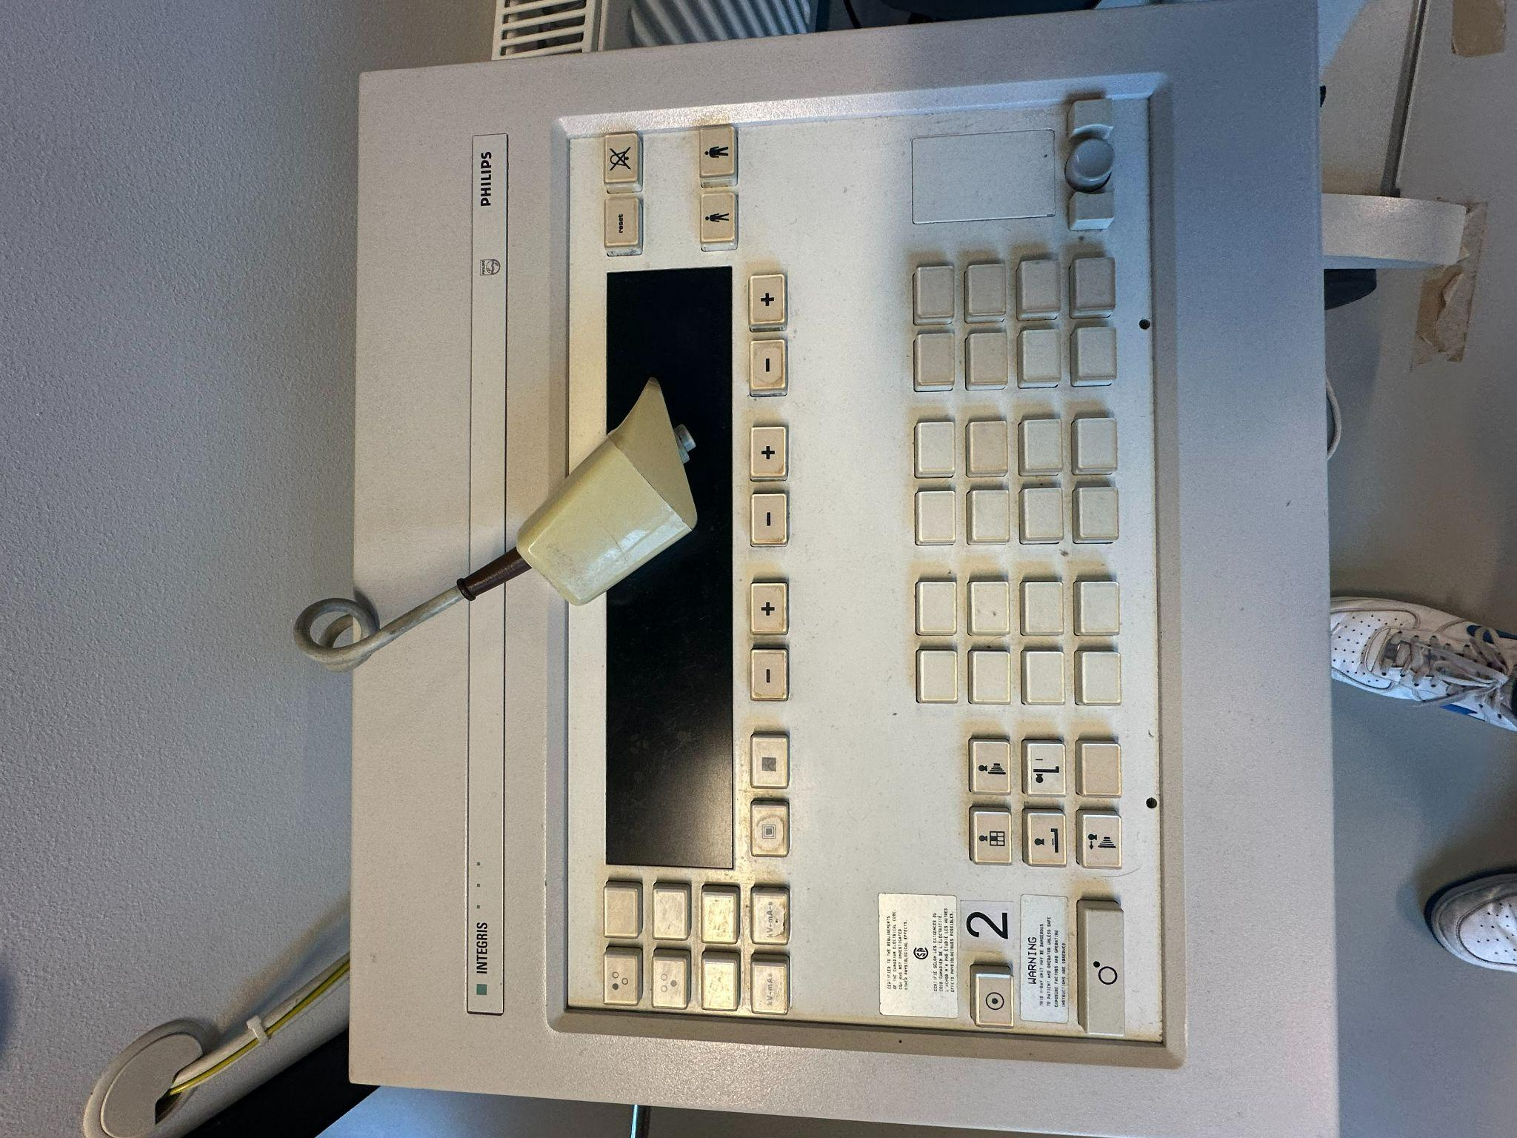
larger system used for interventional radiology or cardiovascular imaging
The purpose of larger systems used for interventional radiology or cardiovascular imaging is to provide high-resolution, real-time imaging to guide minimally invasive procedures, enabling precise diagnosis and treatment of various conditions.

Slide 8
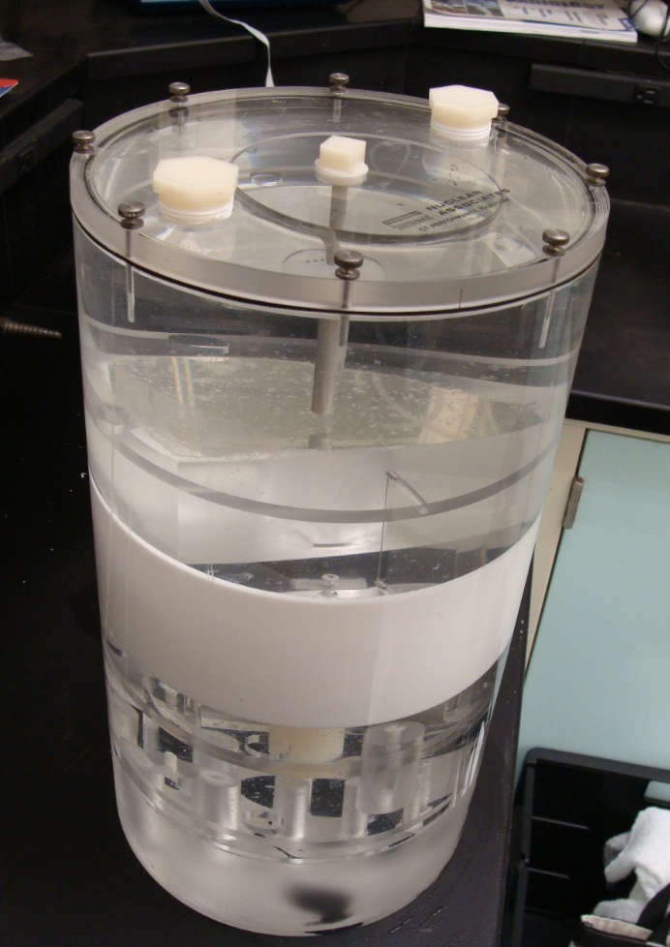
Phantoms
There are different types of phantoms, but these resources provide students with hands-on experience similar to what they will encounter in their medical careers. Phantoms serve as versatile tools in medical training, simulating different body structures, diseases, and conditions, offering realistic scenarios for diagnostic practice.

Slide 9
5 key jargons
Piksis
Phantom - object used to simulate human tissue for imaging and radiation experiments.

Slide 10
5 key jargons
Contrast Media - Substances like iodine or barium used to enhance the visibility of structures in medical imaging.
Radiographic Density - The degree of darkness on an X-ray image.
Dose Optimization - The process of minimizing radiation exposure to human body.

Slide 11
Thank you for your attention!

